Slide 1

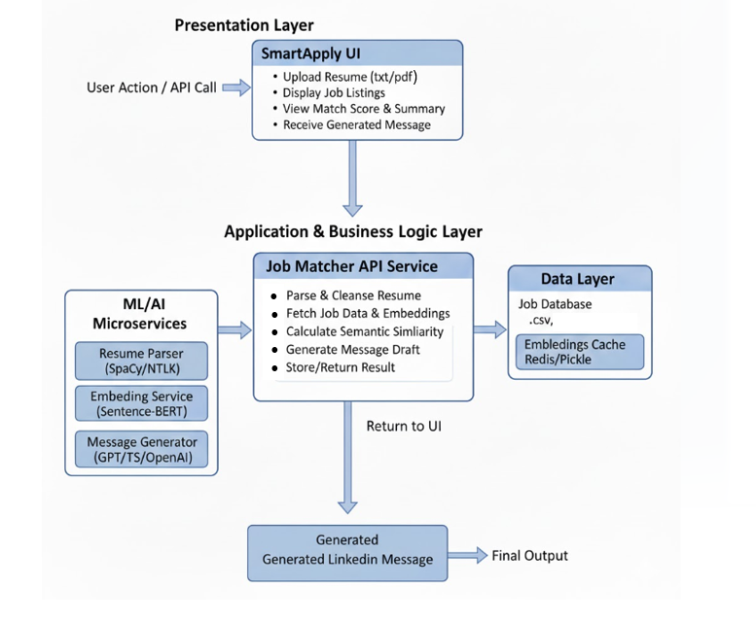
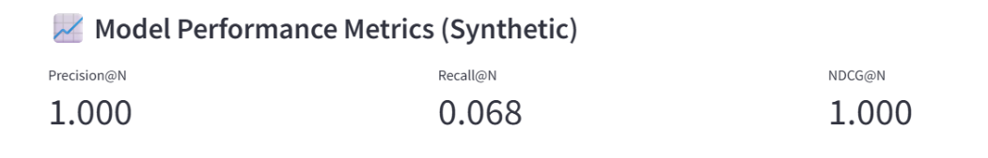
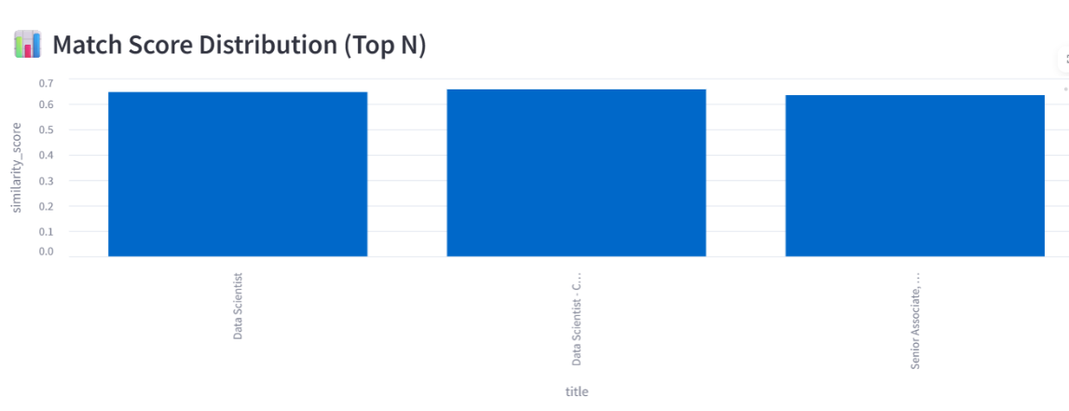
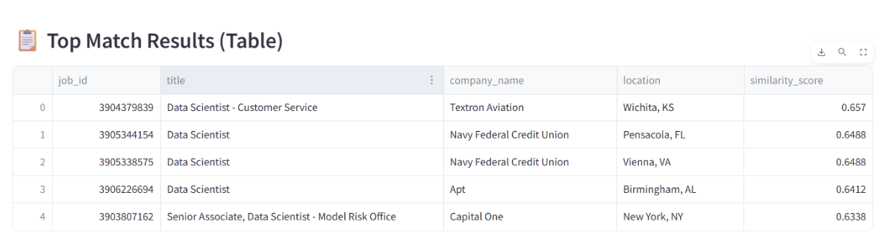
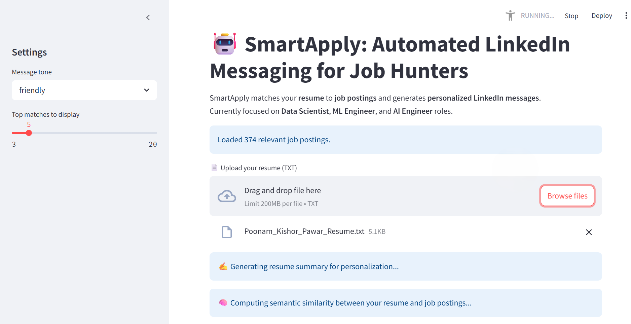
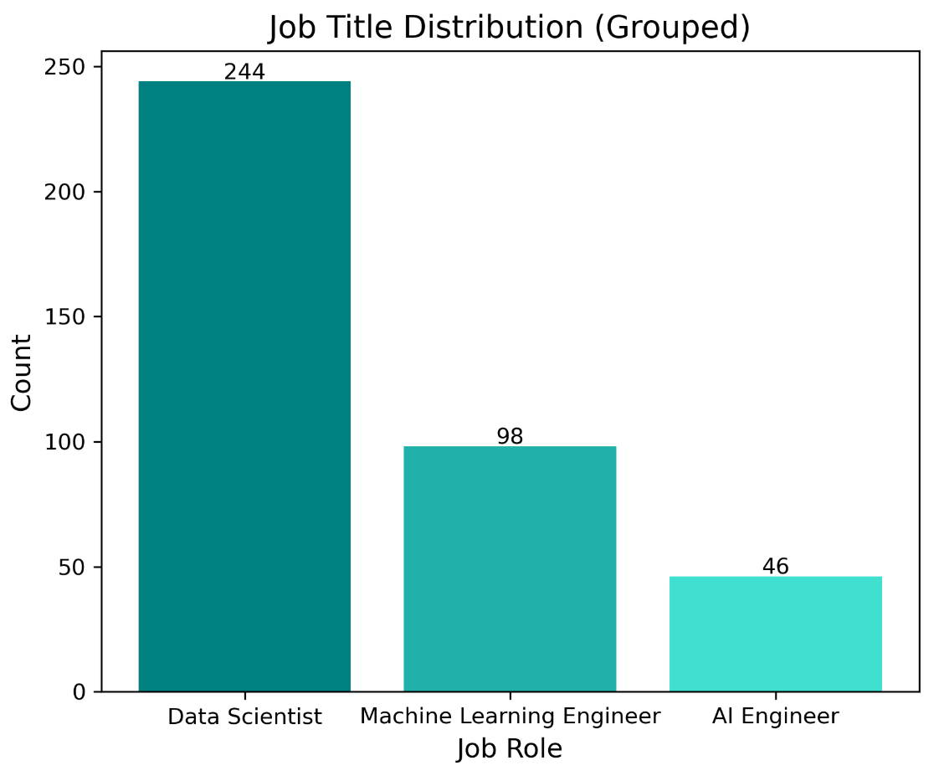
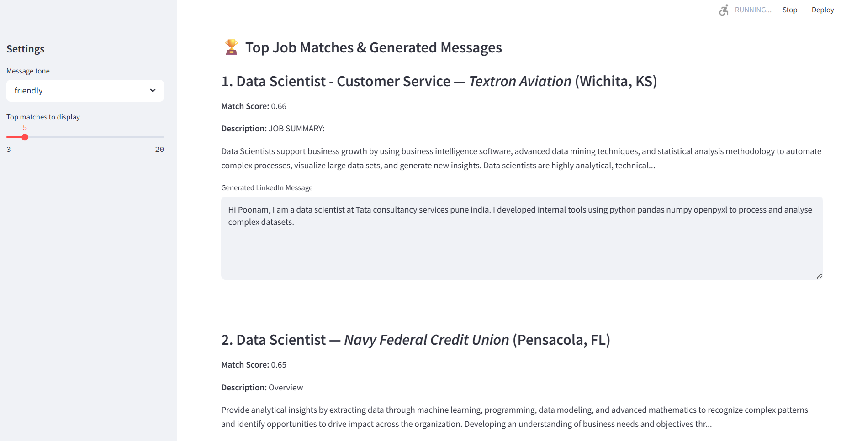
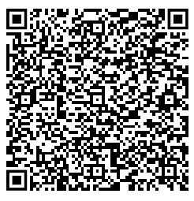

SmartApply: Automated LinkedIn Messaging for Job Hunter
Poonam Kishor Pawar Masters in Applied Data Science p.pawar@ufl.edu
BACKGROUND
SYSTEM ARCHITECTURE
IMPLEMENTATION RESULTS
Background
AI and NLP are increasingly used to streamline job applications and recruitment workflows.
Crafting personalized messages for job applications is time-consuming for candidates.
SmartApply is proposed as an AI-driven system that automates resume–job matching and generates tailored LinkedIn messages.
The system uses NLP for semantic understanding of resumes and job descriptions, and AI-based text generation for creating contextually relevant messages.
Problem to Solve
Improve accuracy of automated resume–job matching using advanced NLP methods.
Automatically generate personalized, professional LinkedIn messages to reduce manual effort.
Build a fully integrated end-to-end pipeline for data processing, job matching, and message generation across platforms.
1. Presentation Layer (UI Layer)
User-facing interface for interacting with SmartApply
Upload resumes and view matched jobs with scores
Displays personalized LinkedIn message suggestions
Triggers backend processing for all user actions
2. Application & Business Logic Layer
Core processing and decision-making engine
Handles resume parsing and job description retrieval
Generates embeddings and computes semantic similarity
Ranks job matches and creates message drafts
Orchestrates all ML/NLP microservices
3. ML/AI Microservices
Perform specialized AI tasks
Resume parsing using NLP (SpaCy/NLTK)
Skill extraction and keyword mapping
Sentence-BERT embeddings + similarity scoring
GPT-based personalized message generation
4. Data Layer
Stores job postings, logs, metrics, and cached embeddings
Ensures fast access to data for all components
Supports efficient similarity computations
Enables scalable storage and retrieval
DATA / DATASET
Main datasets include:
Job Postings Dataset: Contains job titles, descriptions, required skills, location, and company information.
Resumes Dataset: Contains candidate profiles including education, skills, experience, and previous job titles.
Matched Jobs Dataset: Pre-processed dataset containing job-resume pairs with match labels for training and evaluation of the matching module.
KEY TAKEAWAY
Traditional job-matching tools miss context and relevance due to keyword-only filtering.
SmartApply uses AI and Sentence-BERT embeddings for context-aware resume–job matching.
The system combines resume parsing, skill extraction, matching, and message generation seamlessly.
Embedding caching and modular architecture make SmartApply fast, efficient, and scalable.
AI-generated LinkedIn messages reduce manual effort and improve recruiter engagement.
The system achieves high matching accuracy and strong message quality based on evaluation metrics.
SmartApply enhances job search personalization and improves the overall applicant experience.
REFERENCE
[1] N. Reimers and I. Gurevych, “Sentence-BERT: Sentence Embeddings using Siamese BERT Networks,” EMNLP, 2019. (Used for SentenceTransformer “all-MiniLM-L6-v2” model)
[2] M. Lewis et al., “BART: Denoising Sequence-to-Sequence Pre-training,” ACL, 2020. (Used for BART-large-CNN summarization)
[3] H. Chung et al., “Scaling Instruction-Finetuned Language Models,” arXiv:2210.11416, 2022. (Used for Google’s FLAN-T5-Large)
ACKNOWLEDGEMENT
Please use this QR to view the demo Login with UF IDs only
Instructor:
Dr. Andrea Ramirez-Salgado

